Slide 1
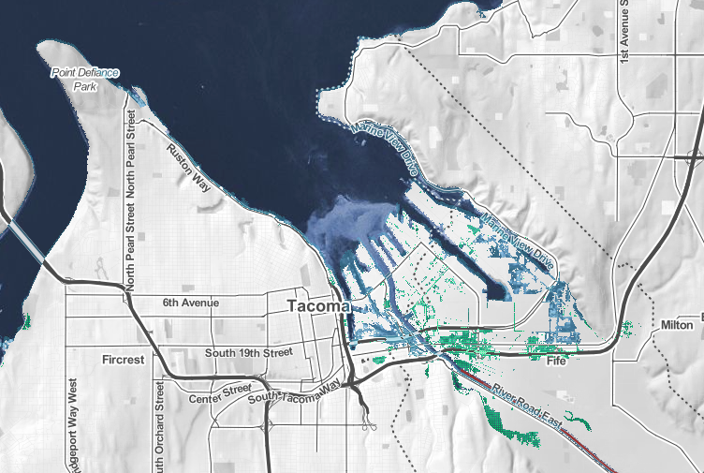
Sea Level Rise Impacts in Tacoma

Slide 2
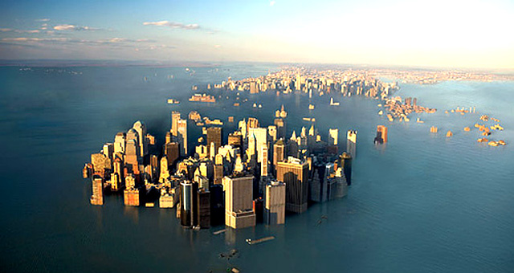
Sea Level Rise Scenarios for Decision-Making
Global Sea Level Rise (SLR) is estimated to range from 0.2 to 2+ meters by 2100
Given this uncertainty, decision-makers can use a scenario approach to model various outcomes given different levels of SLR.
“Scenarios are used to develop and test decisions under a variety of plausible futures. This approach strengthens an organization’s ability to recognize, adapt to, and take advantage of changes over time” (Parris et al., 2012).

Slide 3
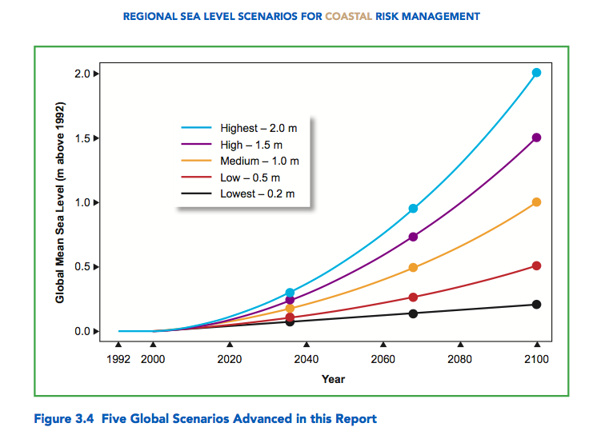

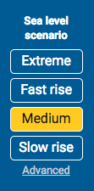
Sea Level Rise Scenarios
???
Highest (2.0 m)
→ Medium (1.0 m)
→ Lowest (0.2m)
What is the Extreme scenario?
Notes:
Hall, J.A., S. Gill, J. Obeysekera, W. Sweet, K. Knuuti, and J. Marburger. 2016. Regional Sea Level Scenarios for Coastal Risk Management: Managing the Uncertainty of Future Sea Level Change and Extreme Water Levels for Department of Defense Coastal Sites Worldwide. U.S. Department of Defense, Strategic Environmental Research and Development Program. 224 pp.

Slide 4
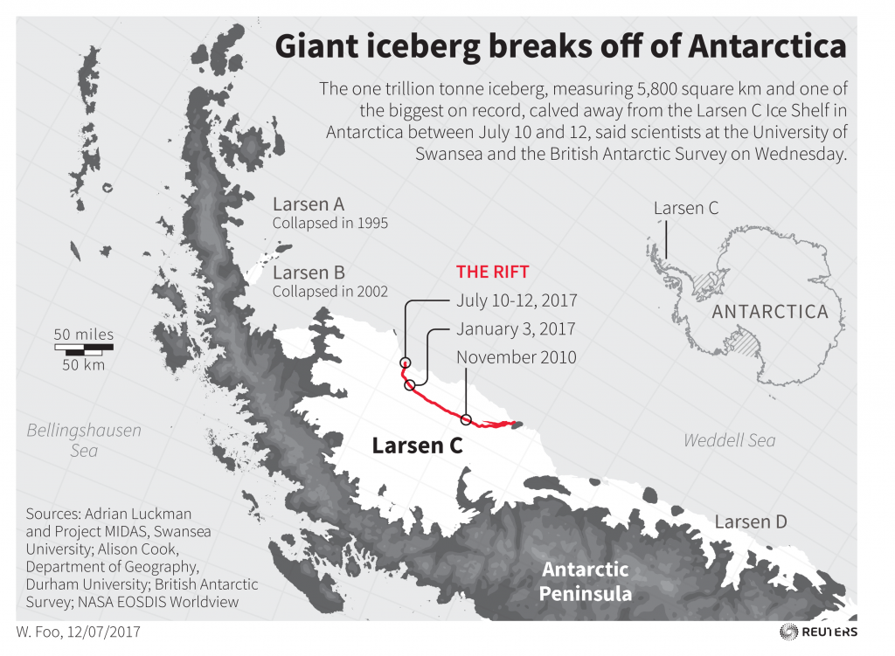
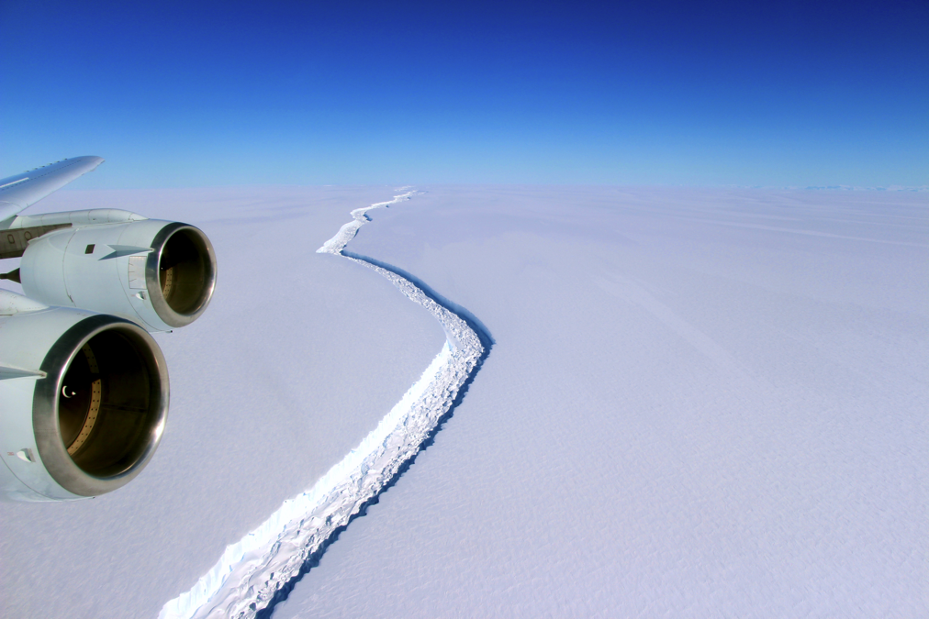
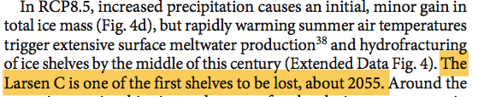
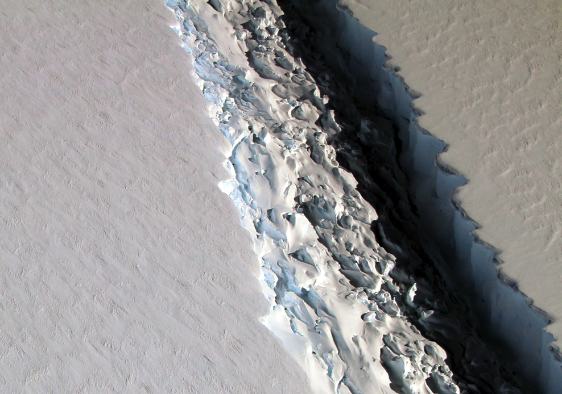
- DeConto and Pollard 2016, Nature

Slide 5
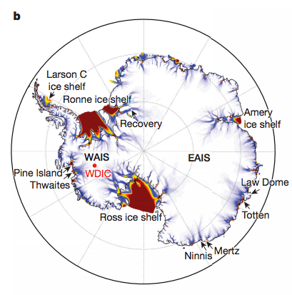
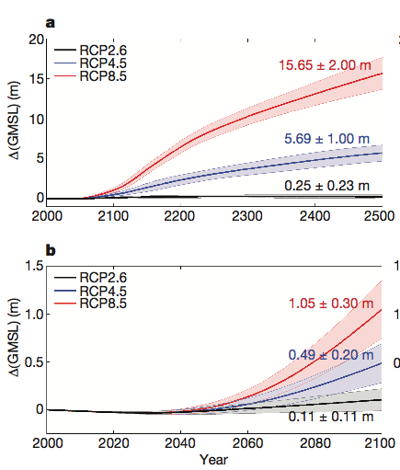
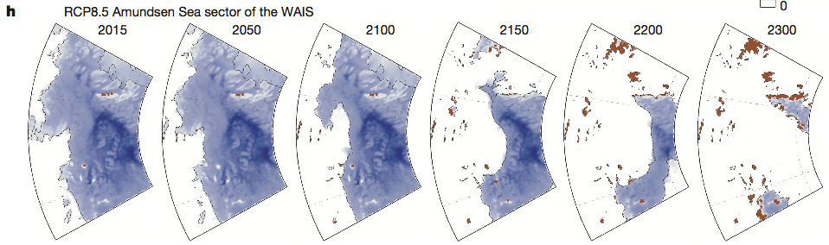
Future Antarctic Contributions to Sea Level Rise
Representative Concentration Pathways (RCP)
RCP8.5 – fossil fuel intensive high emissions scenario or business as usual
RCP4.5 - moderate emissions stabilizing by 2050 then declining
RCP2.6 – drastically cut back on CO2 emissions taking immediate actions
Amundsen Sea

Slide 6
Sea Level Rise Scenarios
Extreme (3 m)
Highest (2.0 m)
→ Medium (1.0 m)
→ Lowest (0.2m)

Slide 7
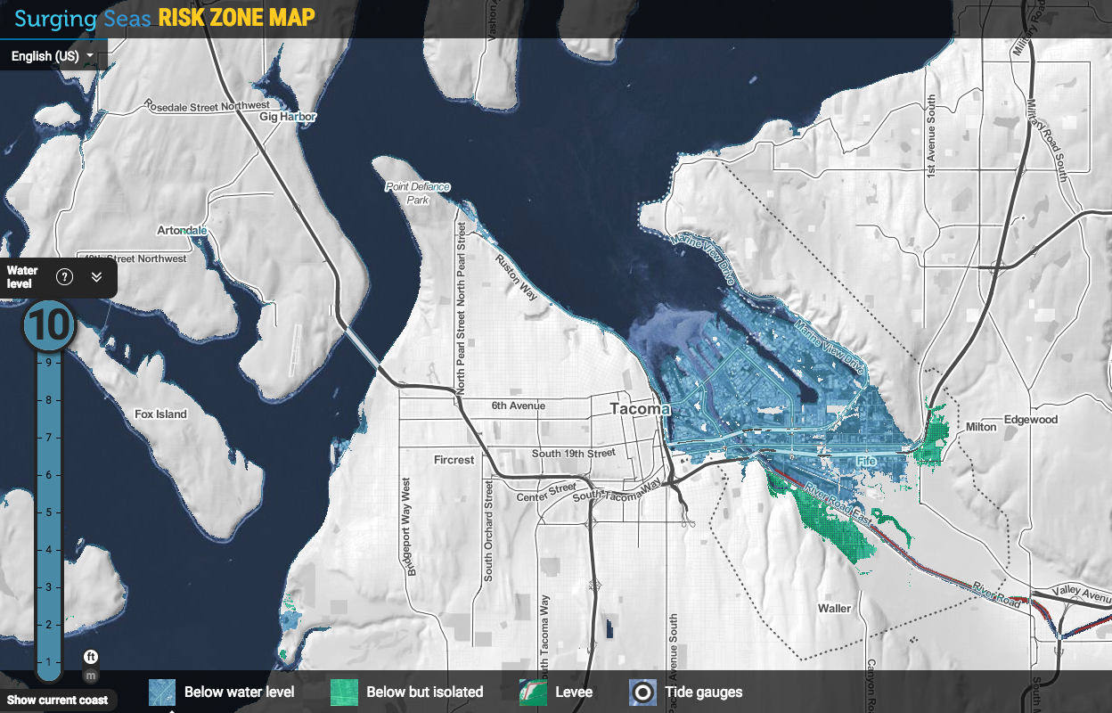

Slide 8
Part I. Tools for Analysis: Marginal Damage Curves
Example: Marginal Damages of Pollution
As CO₂ emissions increase, the damage cost from each additional ton of pollution is more than the previous ton.
CO₂ Marginal Damage Curve
$
Marginal Damage
What area on the graph represents the
Total Damage Costs from Q₂ tons of CO₂?
What are represents the marginal
Damage costs from Q₁ to Q₂?
150
100
0
Q₁
Q₂
Tons CO₂

Slide 9
Part II. Tools for Analysis: What are the expected damage costs of flooding?
Expected Value Analysis
, or
We can use expected value analysis to incorporate risk into our decision-making by multiplying the damage costs of a flood event (x_{j}) by the probability of the flood occurring, p(x_{j}) for ‘n’ potential outcomes.
In this case, n=2, Flood or No Flood

Slide 10
Part II. Tools for Analysis: What are the expected damage costs of flooding?
Calculating expected damages from SLR and flooding in Tacoma
E[x_{i} ] = x_{F,i}*p_{F,i} + x_{NF,i}*p_{NF,i}
E[X_{i}] is the expected damage from a maximum flood height of i, for i=1, 2, …10
For each flood level, i, there is probability p_{F,i} of Flooding which would cause x_{F,i} dollars in property damages.
What is the value of the second term, x_{NF,i}*p_{NF,i}? Why?
p_{NF,i} is the probability of No Flood in which case damages would be 0, or x_{NF,i} = 0
Thus, our calculation simplifies to: E[x_{i} ] = x_{F,i}*p_{F,i} for i= 1, 2, …10

Slide 11
Part IV. Tools for Analysis: How much to spend on adaptation to Sea Level Rise?
Principle of Marginal Analysis
The optimal quantity, Q* , is where the Marginal Benefit = Marginal Cost
Why would Q’ not be optimal? Q’’?
The Total Cost of Q* is the area under the Marginal Cost curve from 0 to Q*
What area represents the Total Value of Benefits at Q*?
How could this principle apply to decisions on sea level rise adaptation in Tacoma?
What are the costs and benefits?
$
Marginal
Cost
Marginal
Benefit
0
Q’
Q*
Q’’
Q Quantity

